Slide 1

Debiasing Career Recommendations with Neural Fair Collaborative Filtering
Rashidul Islam¹, Kamrun Naher Keya¹, Ziqian Zeng², Shimei Pan¹, and James Foulds¹
¹University of Maryland, Baltimore County
²Hong Kong University of Science and Technology

Slide 2
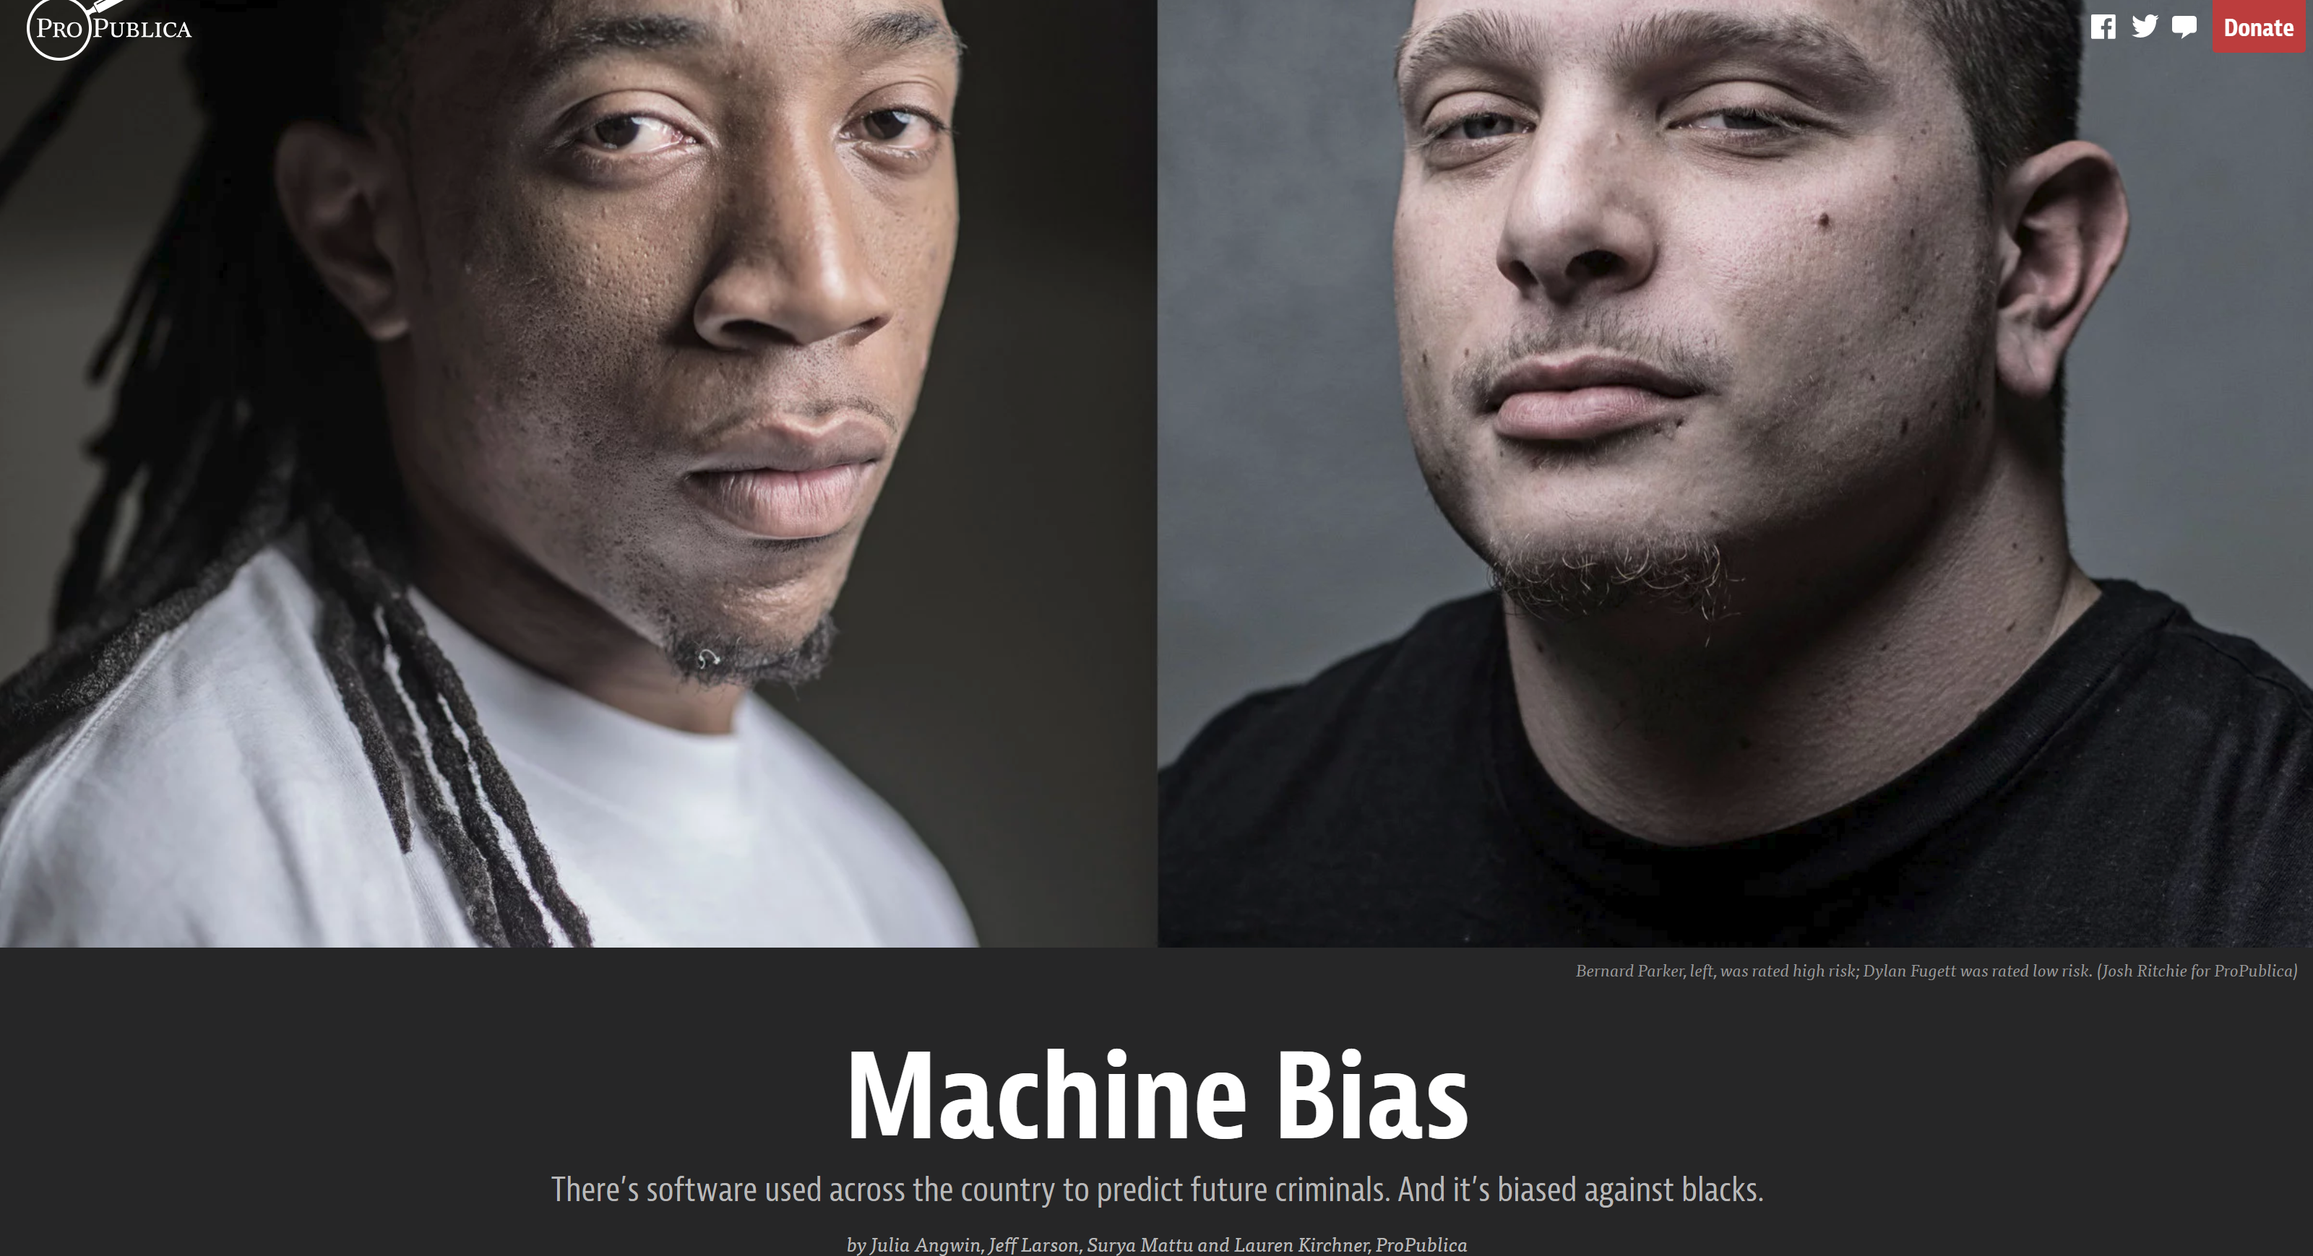
Bias in Predicting Future Criminals
COMPAS
An algorithmic system for predicting risk of re-offending in criminal justice
Used for bail and sentencing decisions across the U.S.
 | WHITE | AFRICAN AMERICAN
Labeled Higher Risk, But Didn’t Re-Offend | 23.5% | 44.9%
Labeled Lower Risk, Yet Did Re-Offend | 47.7% | 28.0%
J. Angwin, J. Larson, S. Mattu, and L. Kirchner, ProPublica, 2016

Slide 3
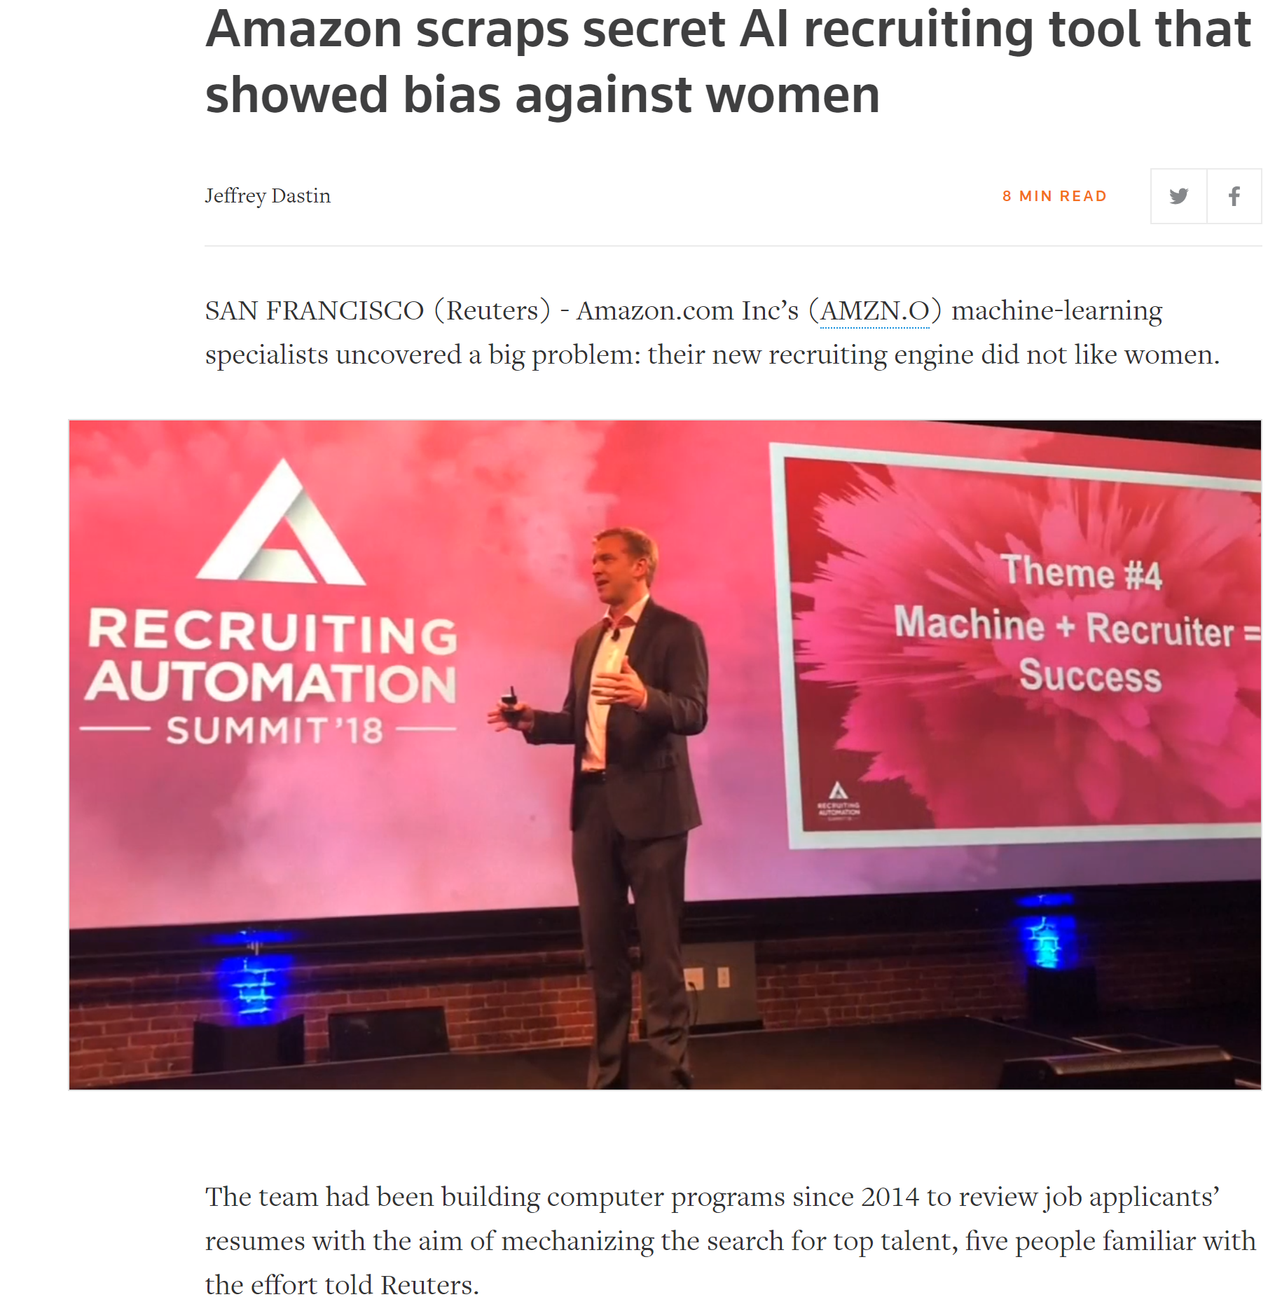

Slide 4
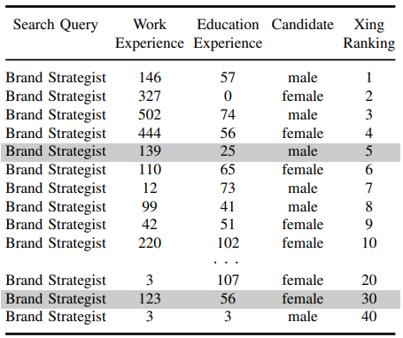
Gender Biased Job Platform
XING, a job platform like LinkedIn
Ranks less qualified male candidates higher than more qualified female candidates
P. Lahoti, K. Gummadi, and G. Weikum. 2019, ICDE), 2019

Slide 5
Inequality in Education System
An earlier study illustrated that the screening process of a medical school in London was highly biased against women and members of ethnic minorities
Stella Lowry and Gordon Macpherson, British Medical Journal, 1988
In 2010, women accounted for only 18% of the bachelor’s degrees awarded in computer science
S. Broad and M. McGee, Association Supporting Computer Users in Education, 2014
Women hold a disproportionately low share of STEM undergraduate degrees, particularly in engineering
D. Beede et al., Economics and Statistics Administration Issue Brief, 2011
Interventions to bridge this gap are crucial to support the economic competitiveness and level of innovation

Slide 6
Our Goal: Fighting the Disparities in AI-Based Career Counseling
Recommender systems can reinforce the demographic disparities/bias, or -potentially- help to mitigate them
Social media data is readily available to support personalized recommendations, as long as bias issues are adequately countered
We envision an ML-based career counseling tool
Makes personalized data-driven recommendations regarding important career choices such as profession, college major, certifications, or jobs
Ensures that the recommendations do not perpetuate harmful stereotypes which are damaging both for our society and the individuals

Slide 7
Existing Works
Analysis of popularity and demographic biases in recommender systems based on evaluation and effectiveness
M. Ekstrand et al., ACM FAccT, 2018
Fair recommendations by penalizing the algorithms for disparate distribution of prediction error
S. Yao and B. Huang, NeurIPS, 2017
Ensuring fairness by making recommended items independent from protected attributes such as gender, race, nationality etc.
T. Kamishima and S. Akaho, FATREC Workshop, 2017
Unlike previous works, we specifically study bias in career recommendations, and develop neural network method for fair collaborative filtering on social media
Notes:
The recommender systems research community has begun to consider issues of fairness in recommendation

Slide 8
Our Contributions
We investigate gender bias in collaborative-filtering recommender systems trained on social media data
We develop neural fair collaborative filtering (NFCF)
A practical technique to mitigate gender bias in sensitive item recommendations
E.g., college major or career path
Achieves accurate predictions while addressing sensitive data sparsity
E.g., users typically have only one or two college majors or occupations
We perform extensive experiments showing both fairness and accuracy benefits over baselines on two datasets
Notes:
by pre-training a deep neural network on big implicit feedback data for non-sensitive items (e.g. “liked” Facebook pages, movies or music), and then fine-tuning the neural network for sensitive item recommendations.
We perform two bias corrections, to address (1) bias in the input embeddings due to the non-sensitive items, and (2) bias in the prediction outputs due to the sensitive items.

Slide 9
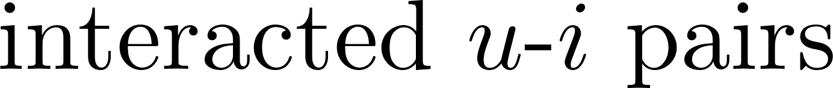
Problem Formulation
The objective function of collaborative filtering problem with implicit feedback

Slide 10
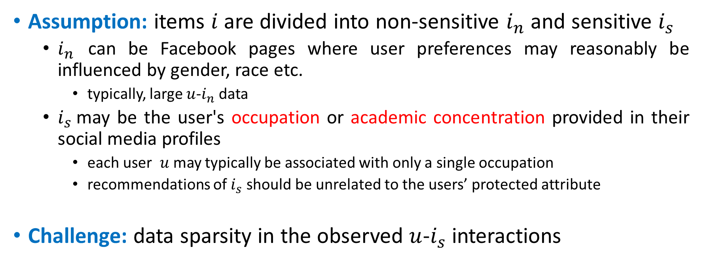
Problem Formulation
Assumption: items $i$ are divided into non-sensitive $i_{n}$and sensitive $i_{s}$
$i_{n}$ can be Facebook pages where user preferences may reasonably be influenced by gender, race etc.
typically, large $u$-$i_{n}$ data
$i_{s}$may be the user's occupation or academic concentration provided in their social media profiles
each user $u$ may typically be associated with only a single occupation
recommendations of $i_{s}$should be unrelated to the users’ protected attribute
Challenge: data sparsity in the observed $u$-$i_{s}$ interactions

Slide 11
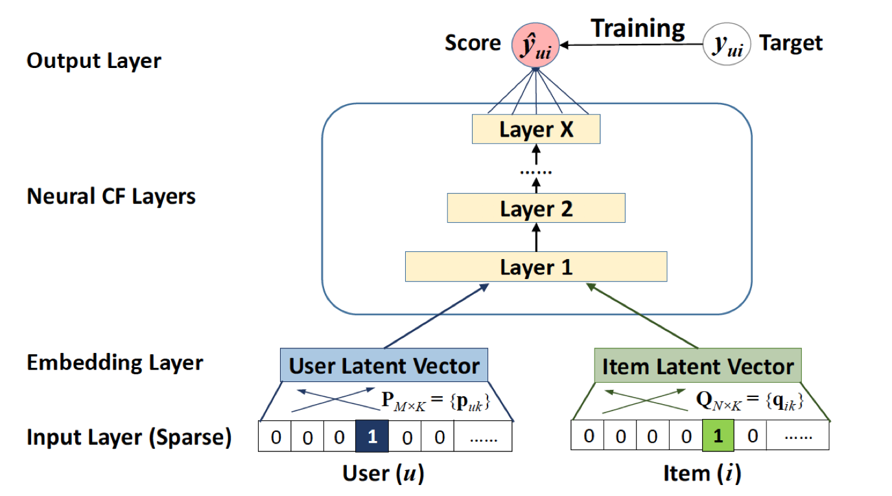
Neural Collaborative Filtering (NCF)
Replaces the matrix factorization with a multilayer neural network
State-of-the-art recommendation performance for implicit feedback problem
But no fairness interventions
X. He et al., WWW, 2017

Slide 12
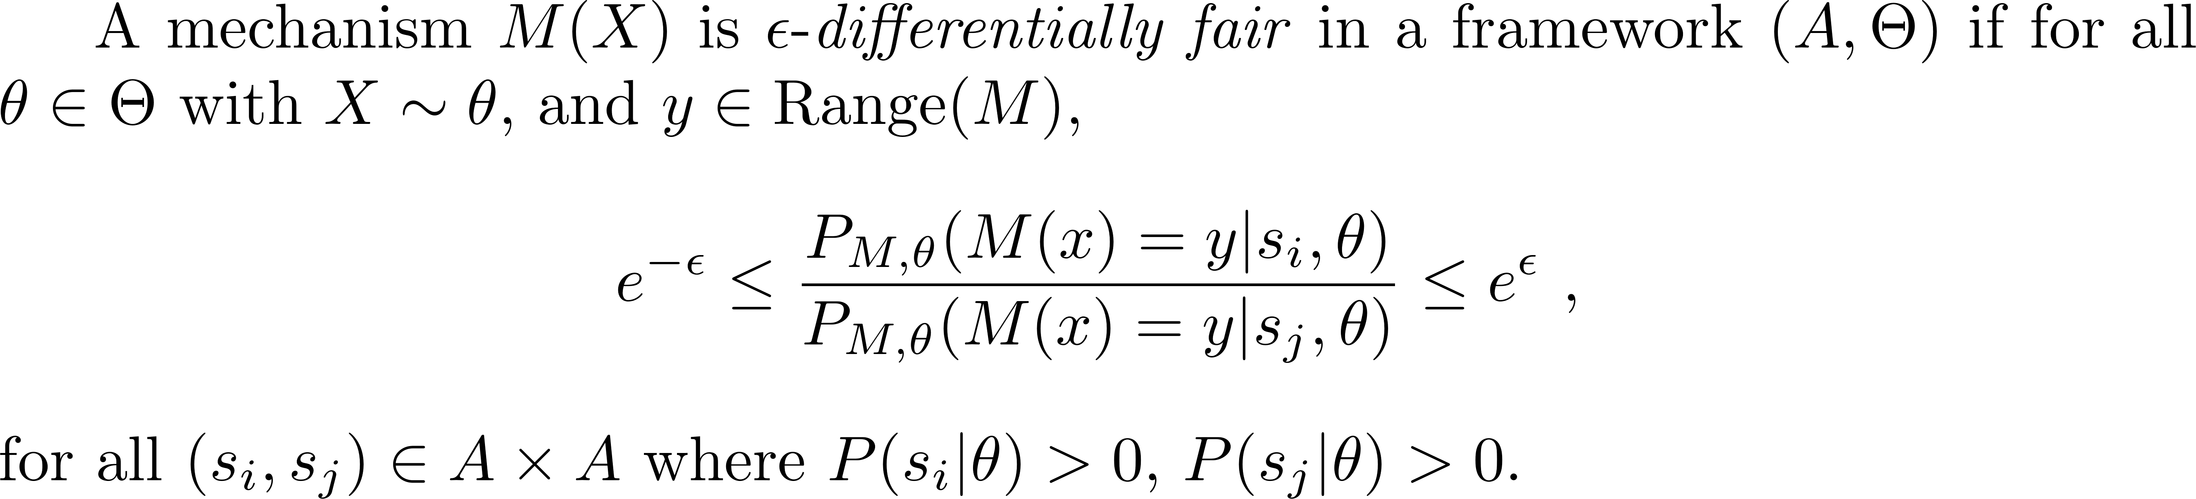
Fairness Metrics
Differential Fairness (DF)
Protected attributes,
e.g. gender, race
Measures fairness cost
AI/ML systems
Distributions which could have generated the data
Probabilities w.r.t. data and mechanism
J Foulds et al., ICDE, 2020
Key idea: ratios of probabilities of outcomes bounded for any pair of values of protected attributes

Slide 13
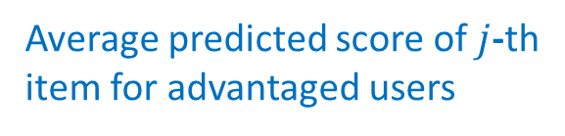
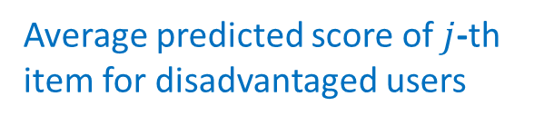
Fairness Metrics
Absolute Unfairness ($U_{abs}$)
Average predicted score of $j$-th item for disadvantaged users
Average predicted score of $j$-th item for advantaged users
Average score for disadvantaged users
Average score for advantaged users
S. Yao and B. Huang, NeurIPS, 2017
Key idea: measures differences in absolute estimation error across user types

Slide 14
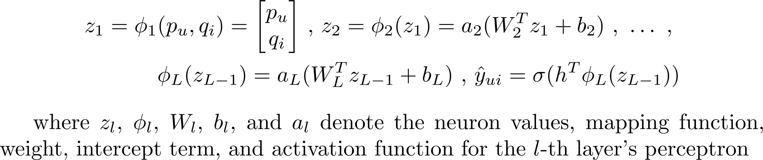
Neural Fair Collaborative Filtering (NFCF)
The main components in NFCF:
an NCF model
pre-training user and non-sensitive item embeddings
de-biasing pre-trained user embeddings
fine-tuning with a fairness penalty
The DNN under the model is defined as
We will show the value of each component with an ablation study

Slide 15
Step-1: Pre-training
NCF is trained to predict users' interactions with non-sensitive items (e.g. ``liked'' social media pages) via back-propagation
No fairness interventions
This leverages plentiful non-sensitive social media data to learn user embeddings of the user's preference and network weights
But it may introduce demographic bias due to correlations with demographics
E.g., liking the “Barbie doll” page typically correlates with user gender
Our aim is to leverage the valuable signal of the user's preferences for improved sensitive item recommendations
But also address the problems with it regarding bias

Slide 16
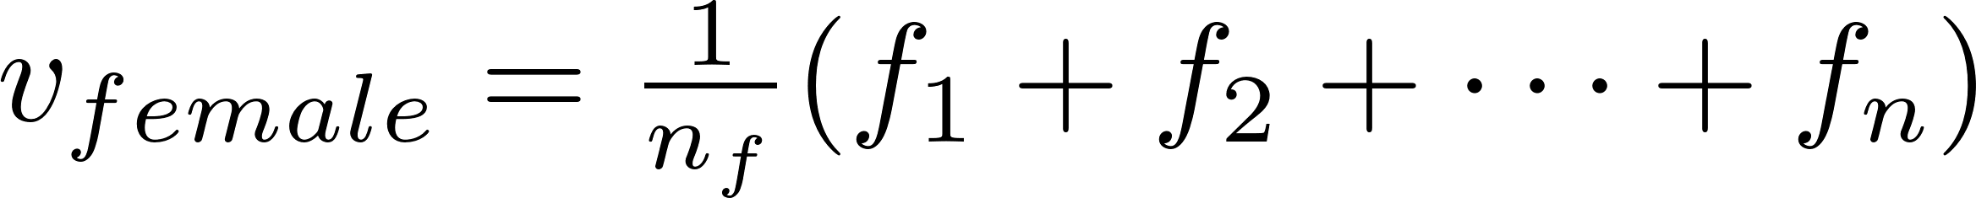
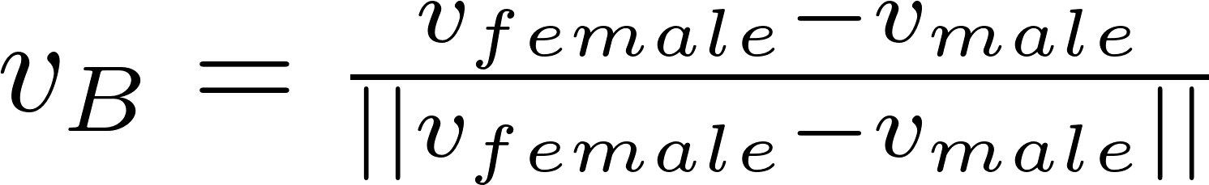
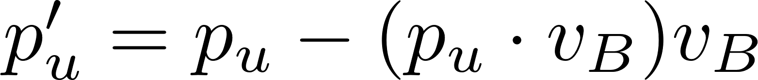
Step-2: De-biasing Embeddings
The user embeddings from step-1 are de-biased
We adapt a very recent work on attenuating bias in word vectors (Dev et al., 2019) to the task of collaborative filtering
First, we compute group specific bias direction for female (or male) users as
Then, we compute the overall gender bias vector using
Finally, we de-bias each user embedding by

Slide 17
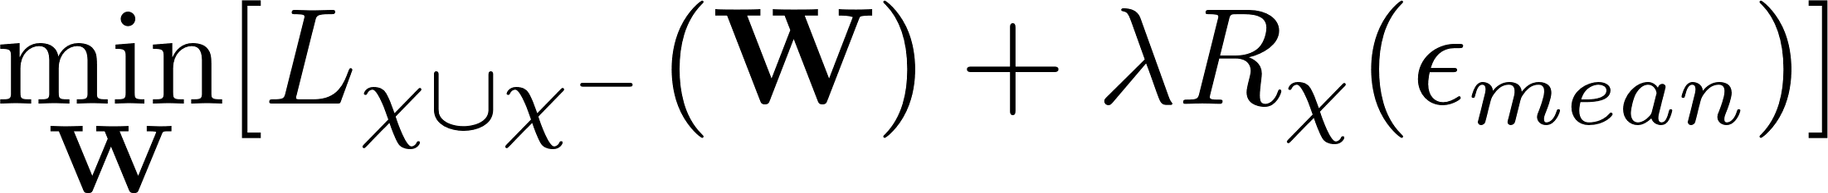
Step-3: Fine-tuning with Fairness Interventions
Transfer the de-biased user embeddings and pre-trained DNN's parameters to a model for recommending sensitive items
The model is fine-tuned for this task
A fairness penalty is added to the objective function to address a second source of bias, e.g., demographic bias in the sensitive items
Using back-propagation, we fine-tune the model by minimizing
Loss function
Tuning parameter
Fairness penalty term

Slide 18
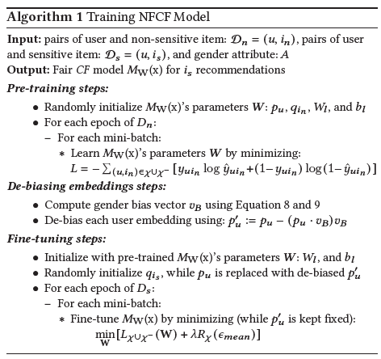
Training Algorithm for NFCF

Slide 19
Variants of NFCF Model
Two variants which are simplifications of the NFCF model: to show the benefit of each component in NFCF
NFCF_embed
This variant only debias user embeddings
Compute the bias vector on the pre-trained user embeddings and fine-tune the model for sensitive item recommendations without any fairness penalty
Since there is no additional fairness penalty, this algorithm converges faster
Projection-based CF
An NCF model is trained for non-sensitive interactions
Debias the user embeddings using our linear projection technique
Learn a classifier on the de-biased user embeddings to predict sensitive items
No fine-tuning to address overfitting or fairness penalty-based bias correction

Slide 20
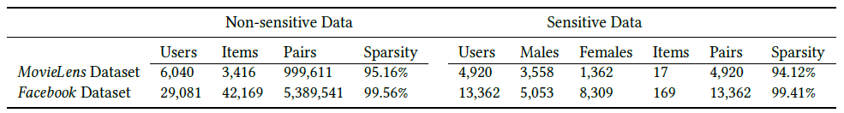
Datasets
Statistics of the experimental datasets

Slide 21
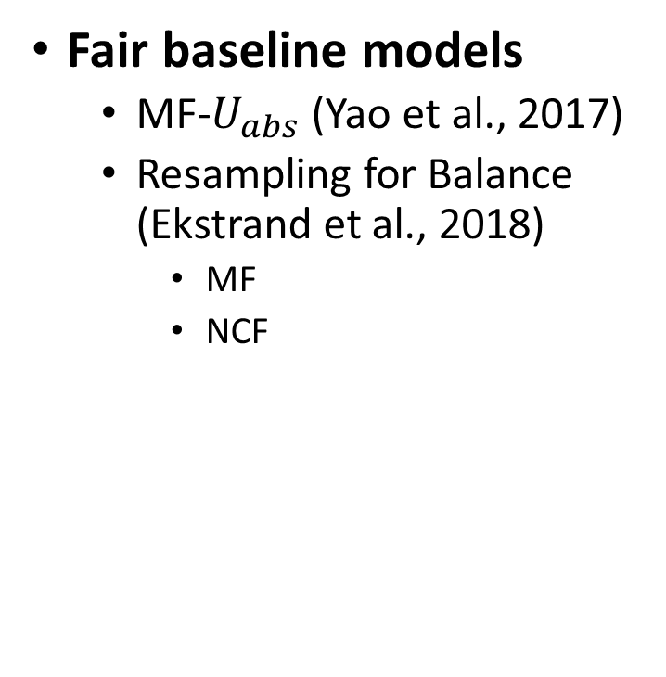
Baselines
Typical baseline models
MF (Koren et al., 2009)
w/o Pre-train
w Pre-train
NCF (He et al., 2017)
w/o Pre-train
w Pre-train
DNN Classifier
BPMF (Salakhutdinov et al., 2008)
Fair baseline models
MF-$U_{abs}$ (Yao et al., 2017)
Resampling for Balance (Ekstrand et al., 2018)
MF
NCF

Slide 22
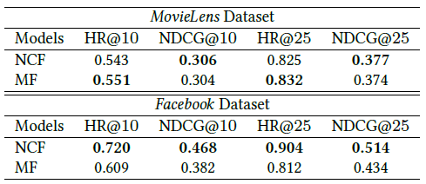
Validation of NFCF Model Design
Pre-training Task Performance
NCF had substantially and consistently showed better performance compared to MF on the larger Facebook dataset, and similar overall performance on MovieLens

Slide 23
Validation of NFCF Model Design
Fine-Tuning Performance
NCF w/ Pre-train had the best performance in NDCG vs. other baselines
Our NFCF and NFCF_embd performed approximately similarly to NCF w/ Pre-train for both datasets
MovieLens
Facebook

Slide 24
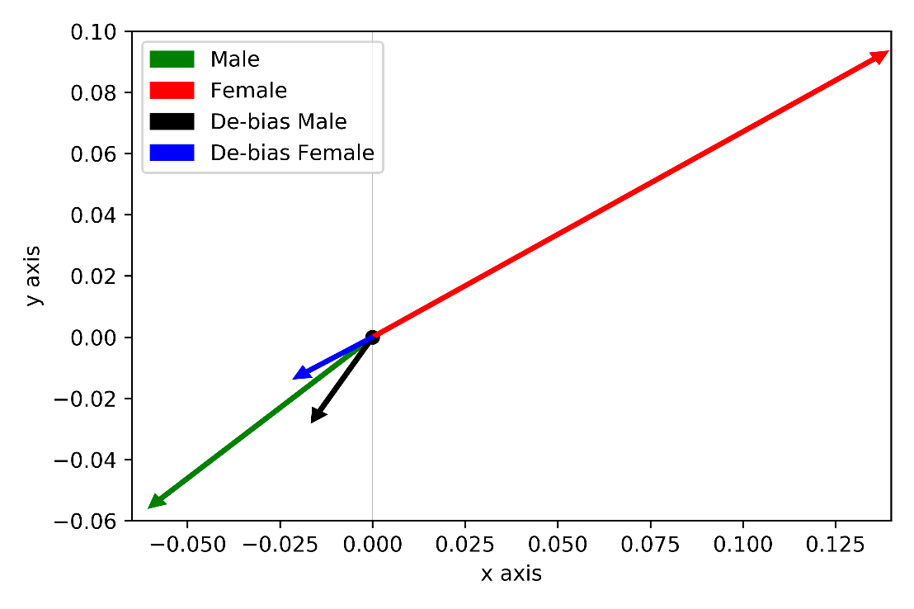
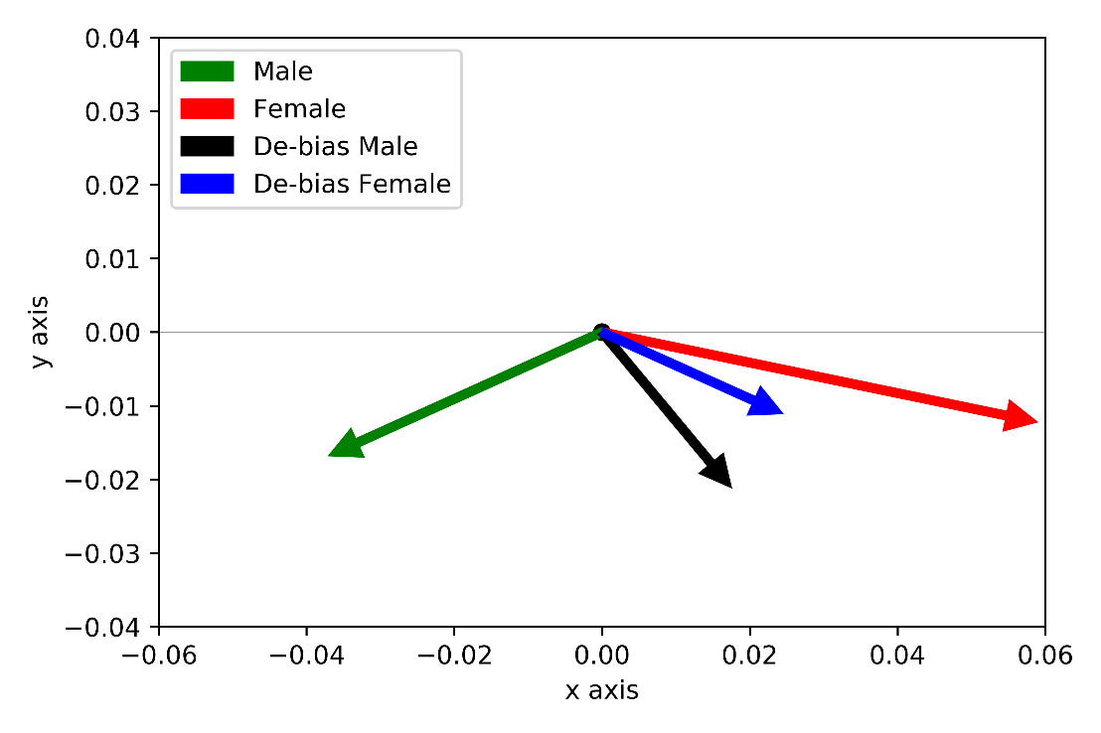
Validation of NFCF Model Design
Visualization of Embedding De-biasing
PCA projections of the male and female vectors before and after the linear projection-based de-biasing embeddings method
MovieLens
Facebook

Slide 25
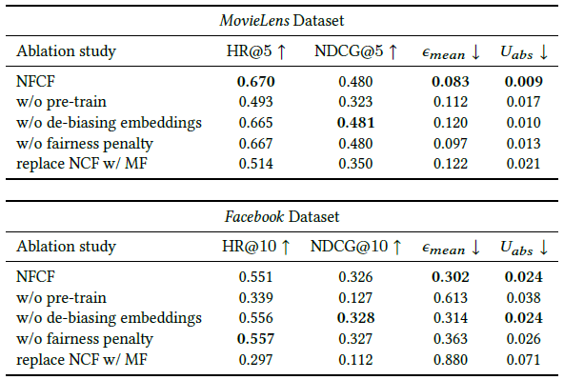
Validation of NFCF Model Design
Ablation Study
A large degradation of the performance of NFCF when:
Pre-training was removed
NCF was replaced by MF

Slide 26
Validation of NFCF Model Design
Ablation Study
Removing the de-biased embedding method led to:
Better scores
But increased gender bias

Slide 27
Validation of NFCF Model Design
Ablation Study
Similarly, learning w/o the fairness penalty led to:
Better scores
But greatly increased gender bias

Slide 28
Performance for Mitigating Gender Bias
Comparison of proposed models with fair baselines
MovieLens
Facebook
NFCF and NFCF\_embd models clearly outperformed all the fair baseline models
Projection-based CF, performed the second best on both datasets

Slide 29
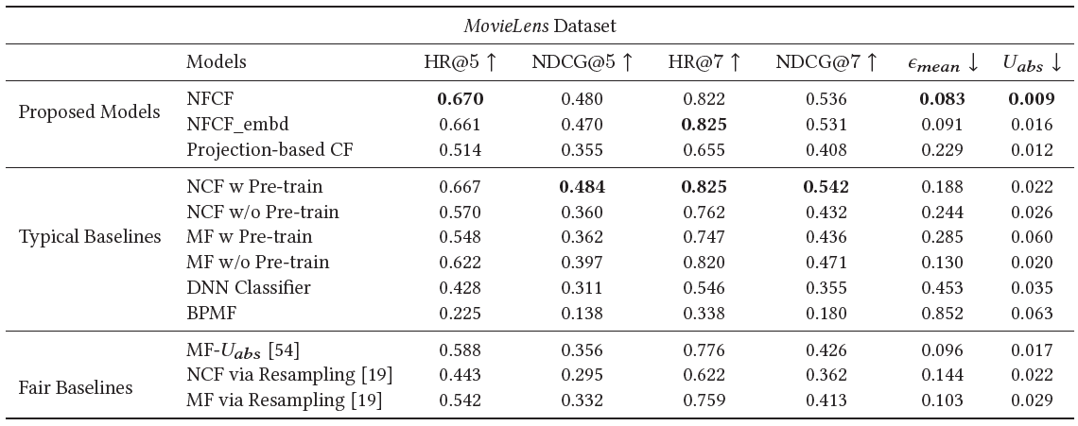
Performance for Mitigating Gender Bias
Top 5 and top 7 career recommendations on MovieLens
The fairest recommender model in terms of both fairness metrics

Slide 30
Performance for Mitigating Gender Bias
Top 5 and top 7 career recommendations on MovieLens
NCF w/ Pre-train performed best in the HR and NDCG metrics

Slide 31
Performance for Mitigating Gender Bias
Top 5 and top 7 career recommendations on MovieLens
NFCF and NFCF_embd had nearly as good HR and NDCG as NCF w/ Pre-train
NFCF and NFCF_embd also mitigate gender bias

Slide 32
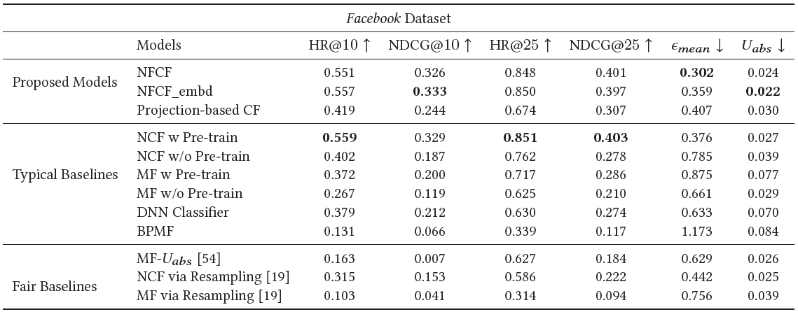
Performance for Mitigating Gender Bias
Top 10 and top 25 college major recommendations on Facebook
The fairest recommender model in terms of $ϵ_{mean}$

Slide 33
Performance for Mitigating Gender Bias
Top 10 and top 25 college major recommendations on Facebook
The fairest recommender model in terms of $U_{abs}$

Slide 34
Performance for Mitigating Gender Bias
Top 10 and top 25 college major recommendations on Facebook
NCF w/ Pre-train again performed best in the HR and NDCG metrics

Slide 35
Performance for Mitigating Gender Bias
Top 10 and top 25 college major recommendations on Facebook
Again, NFCF and NFCF_embd had nearly as good HR and NDCG as NCF w/ Pre-train
NFCF and NFCF_embd also mitigate gender bias

Slide 36
Gender Distributions
Example careers and college majors for datasets and NFCF model
NFCF decreased the percentage
of women from 97% to 50%
NFCF increased the percentage
of women from 27% to 48%
MovieLens
Facebook

Slide 37
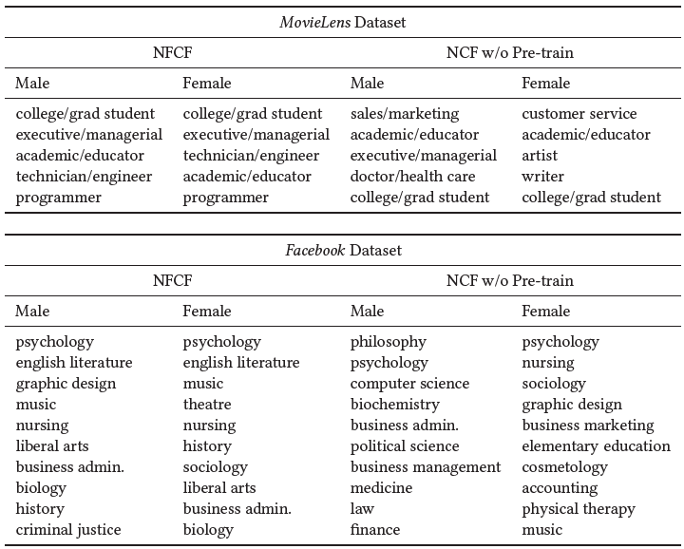
Qualitative Experiment on Career Recommendations
We recommended the top-1 career and college major to each test male and female user via the NFCF and NCF w/o Pre-train models
NFCF was found to recommend similar careers to both male and female users on average
NCF w/o Pre-train encoded societal stereotypes in its recommendations
Recommends computer science to male and nursing to female (Facebook)
Recommends executive/managerial to male and customer service to female (MovieLens)

Slide 38
Conclusion and Future Work
We investigated gender bias in social-media based collaborative filtering
Developed a practical solution for gender de-biased career recommendations while resolving underlying challenges
Achieved better performance and fairness compared to an array of state-of-the-art baseline models
The main limitation of our approach is that it is designed and evaluated for a single protected attribute, i.e., gender or race
In future work, we plan to address this limitation with an adversarial network included in the fine-tuning step
Independent recommendations from multiple protected attributes simultaneously

Slide 39
Thank You
Contact:
Rashidul Islam
Graduate Research Assistant,
Foulds Research Group
Ph.D. Student, Dept. of Information Systems
University of Maryland, Baltimore County
Email: islam.rashidul@umbc.edu
web: https://rashid-islam.github.io/homepage//

